Slide 1

Django Level Three
Time to level up your learning!

Slide 2
Django
Welcome to Django Level Three!
Hopefully you are now excited by the possibilities of the MTV workflows we’ve learned about!
We are still missing a big piece to creating a full website - user input!

Slide 3
Django
In this section we will be covering how to use Django Forms to accept User Input and connect it to the database and retrieve it later on.

Slide 4
Let’s get started!

Slide 5
Django - Basic Forms
Django Level Three

Slide 6
Django
In this lecture we will conceptually walk through the process of creating a form with Django!
We’ve covered Forms when discussing HTML, so why bother with Django Forms?
What extra features do they bring?

Slide 7
Django
Django Forms Advantages:
Quickly generate HTML form widgets
Validate data and process it into a Python data structure
Create form versions of our Models, quickly update models from Forms

Slide 8
Django
The first thing we need to do is create a forms.py file inside the application!
After that we call Django’s built in forms classes (looks very similar to creating models).
Let’s see an example!

Slide 9
Django
Example inside of forms.py:
from django import forms
class FormName(forms.Form):
name = forms.CharField()
email = forms.EmailField()
text = forms.CharField(widget=forms.Textarea)

Slide 10
Django
Note how similar this feels to creating a model!
Now that we have the form created inside the application’s forms.py file, we need to show it by using a view!

Slide 11
Django
Inside our views.py file we need to import the forms (two ways to do this)
from . import forms
from forms import FormName
The . just indicates to import from the same directory as the current .py file

Slide 12
Django
We can then create a new view for the form
def form_name_view(request):
form = forms.FormName()
return render(request,’form_name.html’,
{‘form’:form})

Slide 13
Django
Then we just add the view to the app’s urls, either directly or with include(). Directly:
from basicapp import views
urlpatterns = [
url(r’formpage/’,views.form_name_view,
name = ‘form_name’),
]

Slide 14
Django
We can then create the templates folder along with the html file that will hold the template tagging for the form.
Remember to update the settings.py file to reflect the TEMPLATE_DIR variable!
Also remember that your views should reflect subdirectories inside templates!

Slide 15
Django
So now everything is setup for us to go into the form_name.html file inside templates/basicapp and add in the actual template tagging that will create the Django Form!

Slide 16
Django
There are several ways you can “inject” the form using template tagging. You can just pass in the key from the context dictionary:
{{ form }}

Slide 17
Django
Before we continue, let’s have a quick side discussion about three topics:
HTTP
GET
POST

Slide 18
Django
HTTP stands for Hypertext Transfer Protocol and is designed to enable communication between a client and a server.
The client submits a request, the server then responds.

Slide 19
Django
The most commonly used methods for this request/response protocol are GET and POST.
GET - requests data from a resource
POST - submits data to be process to a resource.

Slide 20
Django
Those are the basics that we need to know for now, but you can check out the w3schools.com page on GET/POST for some more details, like what remains in browser history or what can be cached for future use.

Slide 21
Django
Once you’ve put in the {{forms}} tag you should be able to see a very basic (and ugly) form on the page.
However there is no <form> tag there.
Let’s look at what a more completed form html page would look like...

Slide 22
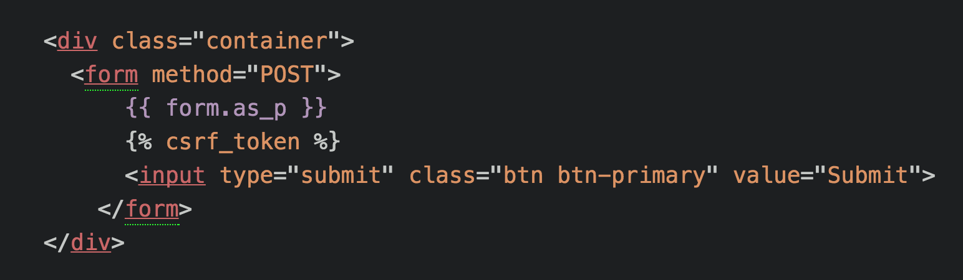
Django
On your form_page.html

Slide 23
Django
Some added Bootstrap class styling calls

Slide 24
Django
Also calling form.as_p which uses <p>

Slide 25
Django
This gives it a nice format to work with.

Slide 26
Django
Check the Django docs for other methods

Slide 27
Django
Also added {% csrf_token %}

Slide 28
Django
This is the first time we’ve encountered thinking about site security measures!
This is a Cross-Site Request Forgery (CSRF) token, which secures the HTTP POST action that is initiated on the subsequent submission of a form.

Slide 29
Django
The Django framework requires the CSRF token to be present.
If it is not there, your form may not work!
It works by using a “hidden input” which is a random code and checking that it matches the user’s local site page.

Slide 30
Django
You just need to remember to put the template tag there, you don’t need to worry about the background.
Now that we can show the form, let’s discuss how to actually handle the form in a view!

Slide 31
Django
Right now if we hit submit, nothing will happen.
We need to inform the view that if we get a POST back, we should check if the data is valid and if so, grab that data.

Slide 32
Django
We can do this by editing the view.
We will talk a lot more about form validation later on, but upon receiving a validated form, we can access a dictionary like attribute of the “cleaned_data”.

Slide 33
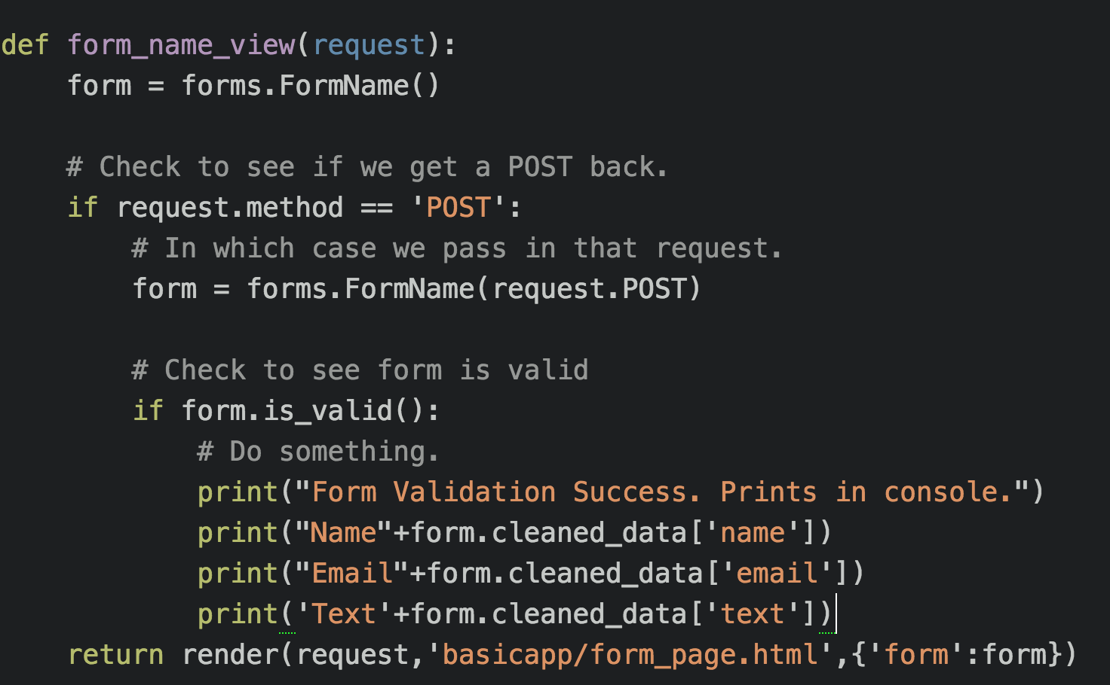
Django

Slide 34
Django
Alright, we still have more topics to cover, like customizing form validation and connecting forms to a model!
Let’s get some practice with what we know so far and create a basic form project and application from scratch!

Slide 35
Django
Once we’ve done that, we’ll revisit our original first_project and see how we can add a form that connects to a model!
Let’s get started!

Slide 36
Form Basics Code Along
Django Level Three

Slide 37
Form Validation
Django Level Three

Slide 38
Django
In this lecture we will discuss hidden fields and how we can use them for custom field validation.
The way our form is set up right now is pretty open to not only users, but potential “bots”.

Slide 39
Django
Django has built-in validators you can conveniently use to validate your forms (or check for bots!)
Everything we do here will be limited to the forms.py file, so we’ll jump right into coding it all out!

Slide 40
Django
We’ll use the basicapp from the previous lecture and work with the following:
Adding a check for empty fields
Adding a check for a “bot”
Adding a clean method for the entire form.

Slide 41
Let’s get started!
Django Level Three

Slide 42
Model Forms
Django Level Three

Slide 43
Django
We’ve seen how we can use Django Forms to grab information from the user and then do something with it.
So far we’ve only printed out that information, but what if we wanted to save it to a model?

Slide 44
Django
Luckily Django makes accepting form input and passing it to a model very simple!
Instead of inheriting from the forms.Forms class, we will use forms.ModelForm in our forms.py file.

Slide 45
Django
This helper class allows us to create a form from a pre-existing model
We then add an inline class (something we haven’t seen before) called Meta
This Meta class provides information connecting the model to the form.

Slide 46
Django
Let’s see some example code of what this new type of ModelForm class would look like.

Slide 47
Django
Example:
from django import forms
from myapp.models import MyModel
class MyNewForm(forms.ModelForm):
# Form Fields go here
class Meta:
model = MyModel
fields = # Let’s see the options!

Slide 48
Django
The fields attribute will connect to model
from django import forms
from myapp.models import MyModel
class MyNewForm(forms.ModelForm):
# Form Fields go here
class Meta:
model = MyModel
fields = # Let’s see the options!

Slide 49
Django
Many ways to make this connection!
from django import forms
from myapp.models import MyModel
class MyNewForm(forms.ModelForm):
# Form Fields go here
class Meta:
model = MyModel
fields = # Let’s see the options!

Slide 50
Django
Need to think about security for fields!
from django import forms
from myapp.models import MyModel
class MyNewForm(forms.ModelForm):
# Form Fields go here
class Meta:
model = MyModel
fields = # Let’s see the options!

Slide 51
Django
Very common to just use this:
from django import forms
from myapp.models import MyModel
class MyNewForm(forms.ModelForm):
class Meta:
model = MyModel
fields = # Let’s see the options!

Slide 52
Django
Have the form be generated from model
from django import forms
from myapp.models import MyModel
class MyNewForm(forms.ModelForm):
class Meta:
model = MyModel
fields = # Let’s see the options!

Slide 53
Django
This saves you work!
from django import forms
from myapp.models import MyModel
class MyNewForm(forms.ModelForm):
class Meta:
model = MyModel
fields = # Let’s see the options!

Slide 54
Django
But if you want custom validators...
from django import forms
from myapp.models import MyModel
class MyNewForm(forms.ModelForm):
class Meta:
model = MyModel
fields = # Let’s see the options!

Slide 55
Django
But if you want custom validators...
from django import forms
from myapp.models import MyModel
class MyNewForm(forms.ModelForm):
# Form Fields go here with validators params
class Meta:
model = MyModel
fields = # Let’s see the options!

Slide 56
Django
Option #1: Set it to “__all__”
from django import forms
from myapp.models import MyModel
class MyNewForm(forms.ModelForm):
# Form Fields go here
class Meta:
model = MyModel
fields = “__all__”

Slide 57
Django
Option #2: exclude certain fields
from django import forms
from myapp.models import MyModel
class MyNewForm(forms.ModelForm):
# Form Fields go here
class Meta:
model = MyModel
exclude = [“field1”,“field2”]

Slide 58
Django
Option #3: List included fields
from django import forms
from myapp.models import MyModel
class MyNewForm(forms.ModelForm):
# Form Fields go here
class Meta:
model = MyModel
fields = (“field1”,“field2”)

Slide 59
Django
Check out the documentation for more discussion on connecting fields in the form to fields in the model.
To get some practice with all of this, let’s try adding a Model Form to our proTwo from Django Level Two!

Slide 60
Django
This project had a single User class in its models, we will connect it to a form allowing users to register their names and emails to the site.
This logic could easily be used to create a simple Coming Soon Landing Page!

Slide 61
Django
To get started, make sure you have the ProTwo folder from the Django Level Two folder in the notes.
To see the completed version of this, check the ProTwo folder in Django Level Three.

Slide 62
Django
Let’s get started!

Slide 63
Model Forms - Exercise
Django Level Three

Slide 64
Django
We will work with the ProTwo project folder from Django Level Two.
Originally the user.html file used template tagging to display a list of all users.

Slide 65
Django
We will change this to be a sign-up page.
Connected to a ModelForm, the user will sign up on the user page and be taken back to the home page.
A great exercise would be to try to do this on your own first!

Slide 66
Django
(Optional) Exercise Steps:
Create a ModelForm in forms.py
Connect the form in the template
Edit views.py to show the form
Figure out how to .save() the data
Verify the model is admin registered

Slide 67
Django
I highly encourage you to try it on your own! You will need to look at the documentation.
Let’s get started!

